Slide 1
VIRTUALIZATION

Slide 2
ROADMAP
What is virtualization?
Virtualization and cloud computing
Types of virtualization
Hypervisor
Benefits
Vendors

Slide 3
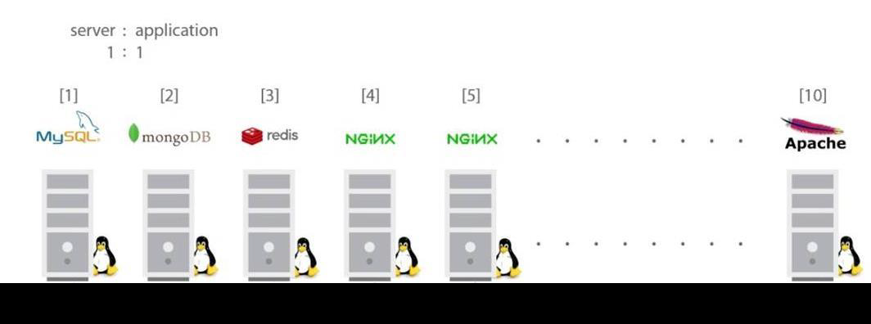
VIRTUALIZATION

Slide 4
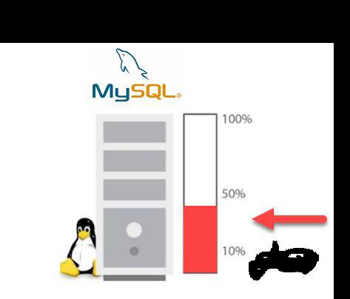
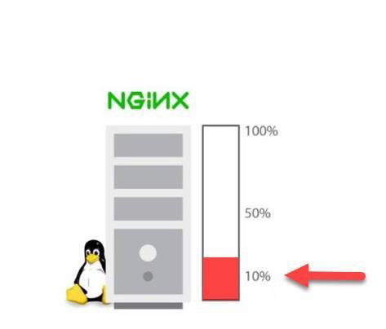

Slide 5
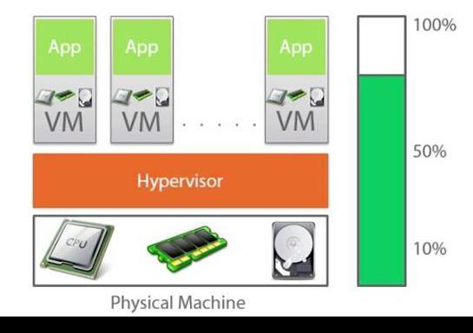

Slide 6
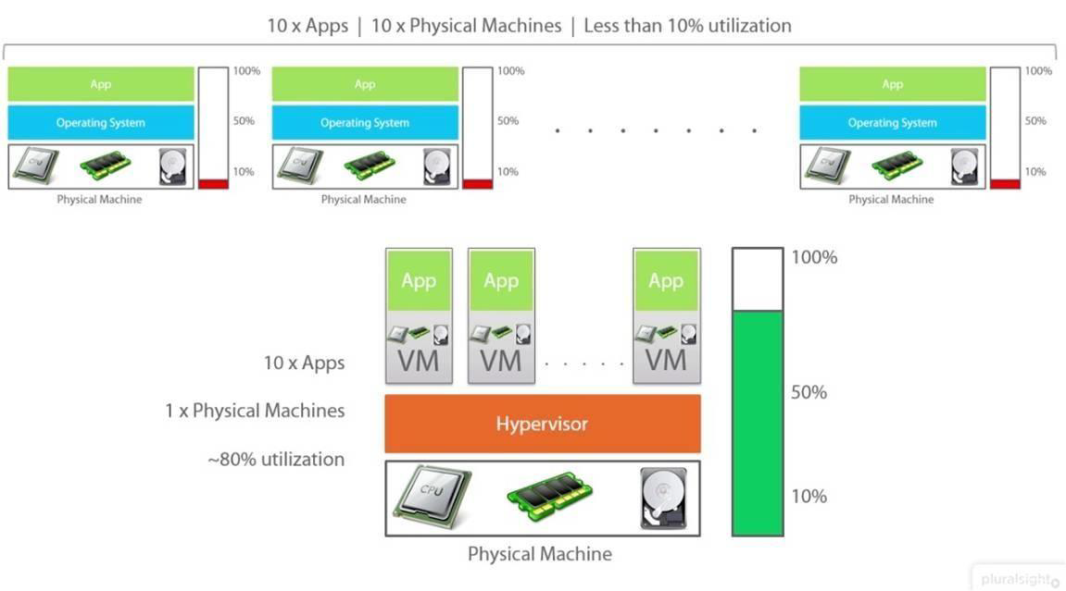

Slide 7
What is Virtualization?
Virtualization is a technology to run multiple same or different operating systems which are completely isolated from each other on the same machine.
Ex: Run both Windows and Linux on the same machine

Slide 8
HOW IT IS DIFFERENT FROM DUAL BOOT?
Both OSes run simultaneously

Slide 9
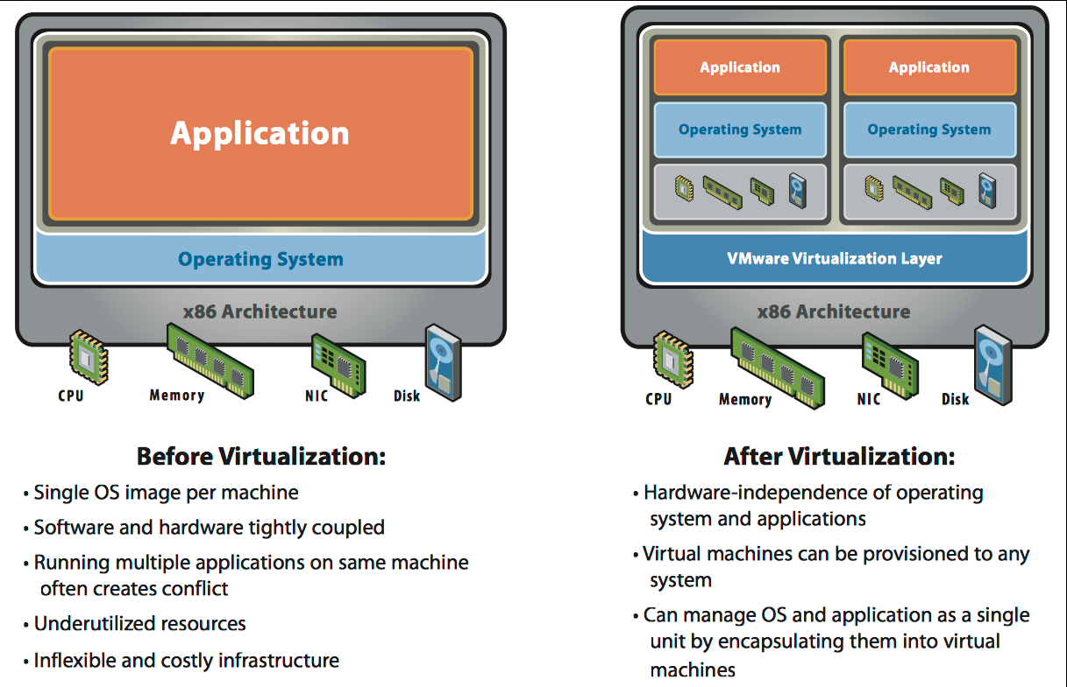

Slide 10
Virtualization and Cloud Computing
Virtualization is a technology whereas Cloud Computing is a service.
Without virtualization, there is no Cloud Computing.
Cloud Computing is built on top of Virtualization.

Slide 11
What IS Hypervisor?
Hypervisor is a software layer that sits between Hardware and OS which will interact with hardware and resources and provide an interface to share the available resources to virtual containers.

Slide 12
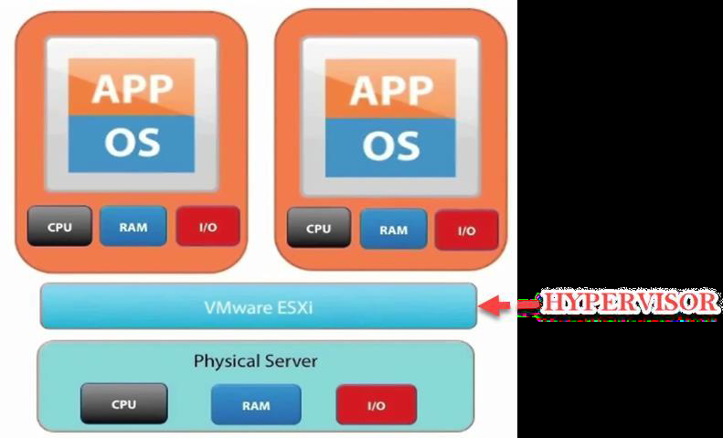

Slide 13
Virtualization Benefits
Virtualization offers major savings in data center operations.
Virtualization makes possible significant reductions in the costs of managing data centers, with simplification of systems management tasks.
Virtualization offers back-up and increased redundancy for delivery of high performance and high availability services.
Virtualization is a step in the direction of “cloud computing”.
Centralized management

Slide 14
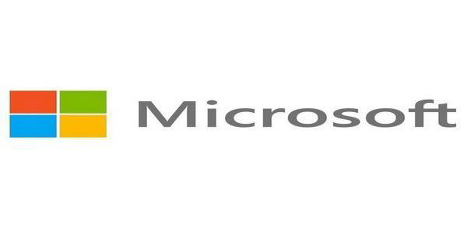
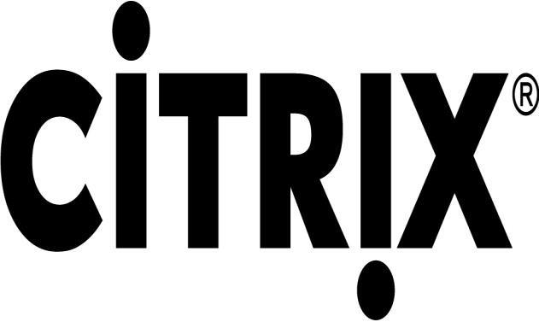
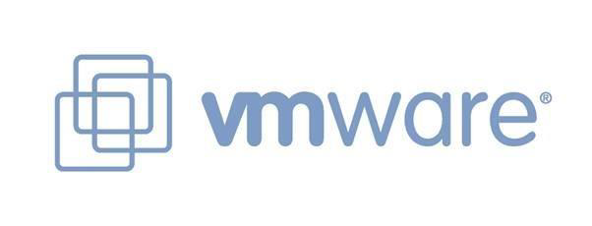
Vendors

